Slide 1

Online retail SHOP MANAGEMENT SYSTEM
A Project by Sonal Lasane & Heramb Kondhare

Slide 2
Introduction
In India, we are availed multiple ways to pay our bills online or trade online. Additionally, there are numerous online ecommerce platforms for Groceries, Fashion, Food, etc. But we still lack of a dedicated online ecommerce platform for disposable and housekeeping items.
Online Retail Shop Management System (ORSMS) fulfills this need of crores of business owners who are struggling because of lack of ‘Ease of Doing Business’ in their area of expertise or marketing.
Both markets have reached the valuation of approximately USD 28,163 Million in the years 2021-2022, despite the country was facing serious economic crisis raised due to Covid-19 and nation-wide lockdown. If an industry can make such huge progress without any dedicated, online ecommerce platform, one can imagine its potential, if it is supported by an online platform.

Slide 3
Problem definition
In India, we have online eCommerce platforms for nearly every business/commercial need, being a regular consumer of those services; I should not necessarily explain the importance of syncing an online eCommerce platform with any business.
Considering the damage caused to Indian economic growth because of the pandemic and nationwide lockdown situations, it is necessary for all kinds of local businesses in the country to be synced with an online eCommerce platform, so that the business, its market, its ecosystem, and an overall economy of the nation can play the role of Phoenix.

Slide 4
Existing System & ‘why’ new System
ORSMS, a dedicated, online eCommerce platform exclusively made for the B2B as well as B2C transactions of single Housekeeping and Disposable Items Business, can manage the operations of such businesses through a single application, to save time and resources of the business owners and administrators.
Currently, business owners owning businesses of housekeeping products and/or disposable items products, have to do business in a typical way, with a lot of paperwork and record maintenance. No business owners can analyze their sales data properly, which leads to a lack of data management aspect in this industry.
This system allows them to keep a track record of the stock available, as well as keep the track record of sellers, who are associated with them. When the product is Out of Stock, the user will get to know the same when they login to the system, in the respective section. This feature can save the time and resources of a seller as well as an admin.

Slide 5
Scope of proposed system
An admin, a seller, or a customer can operate their respective roles from anywhere and at any time through a laptop or mobile phone, instead of physically going to shops or business centers, or warehouses, which can save resources, time, and effort of everyone involved in this business.
A customer has the option to make payment using online mode or Cash on Delivery.
Quick ordering and quick shipping can save the time of an organization, which will eventually lead to the eternal growth of the business.
Being an online shopping website, the platform will get more exposure through Google AdSense and other digital marketing as well as PR tools.

Slide 6
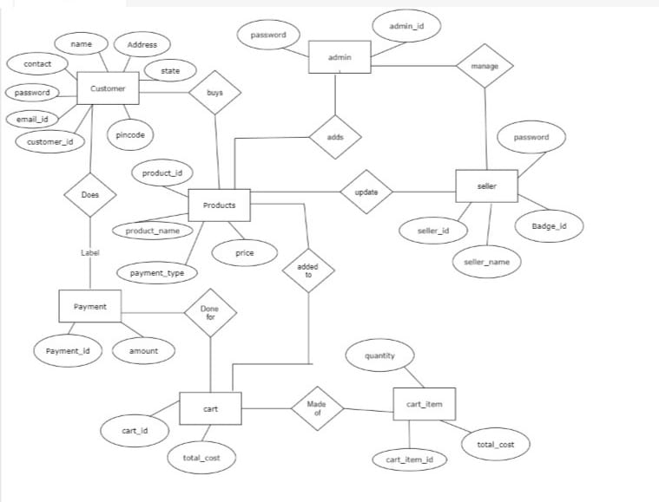
Entity relationship Diagram

Slide 7
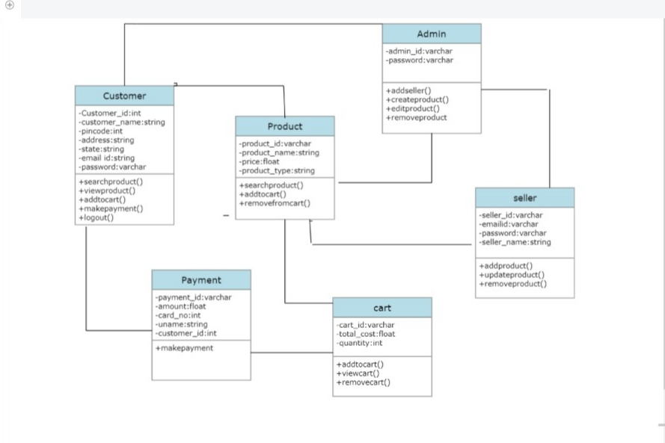
CLASS DIAGRAM

Slide 8
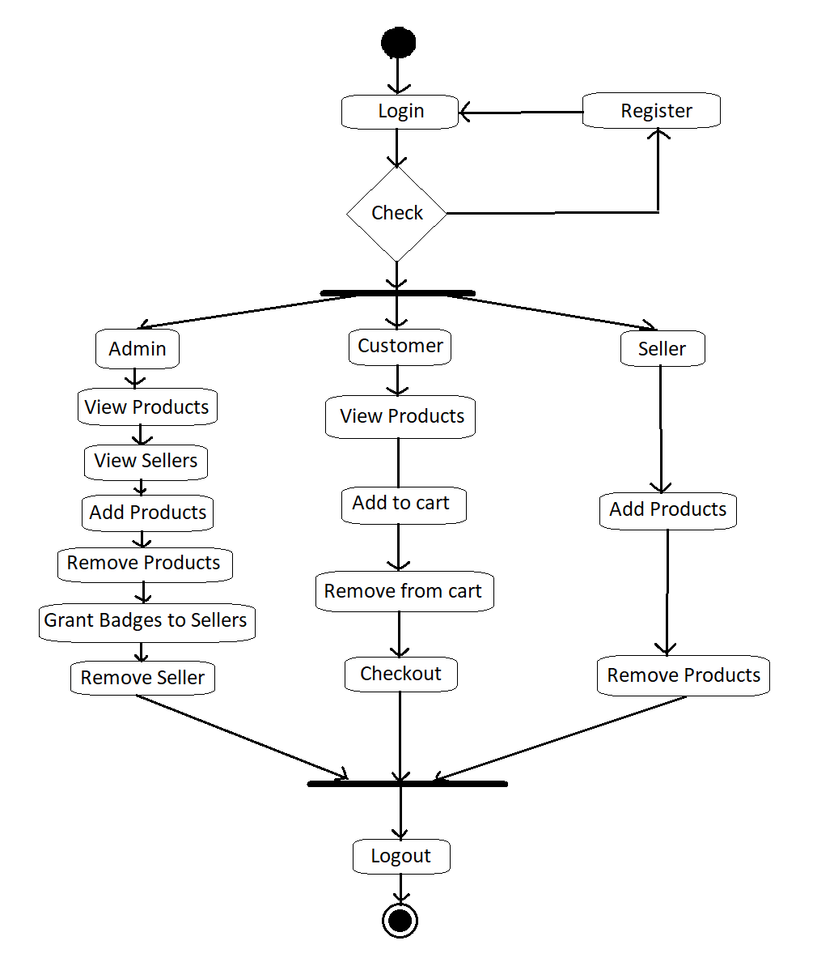
ACTIVITY DIAGRAM

Slide 9
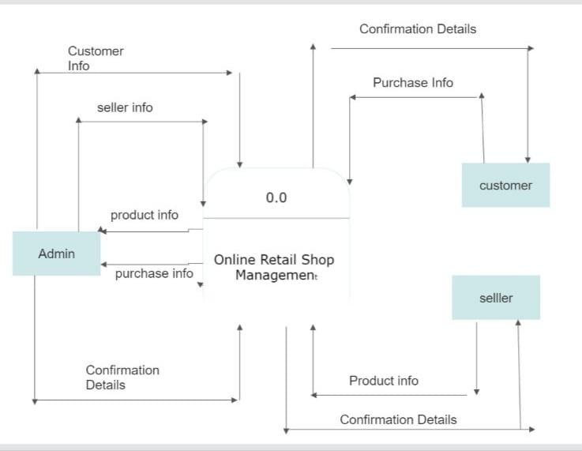
DATA FLOW DIAGRAM

Slide 10
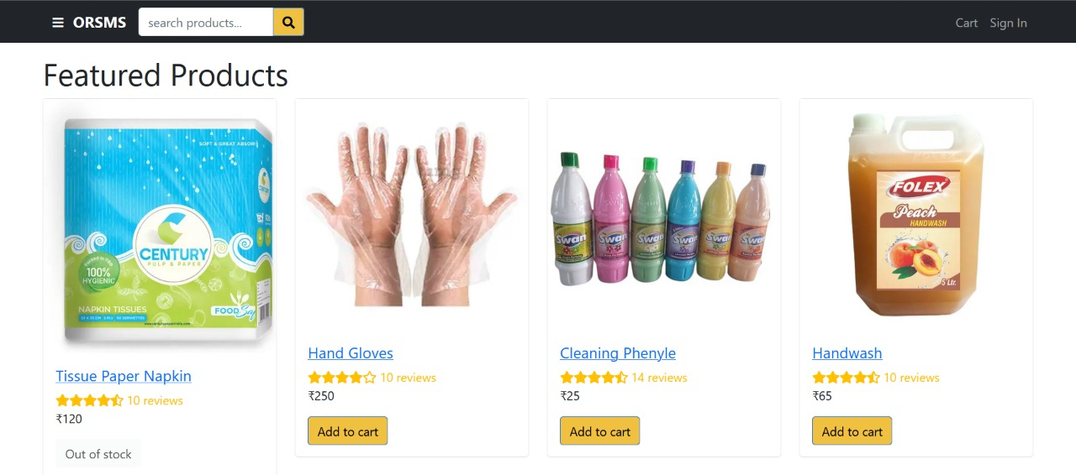
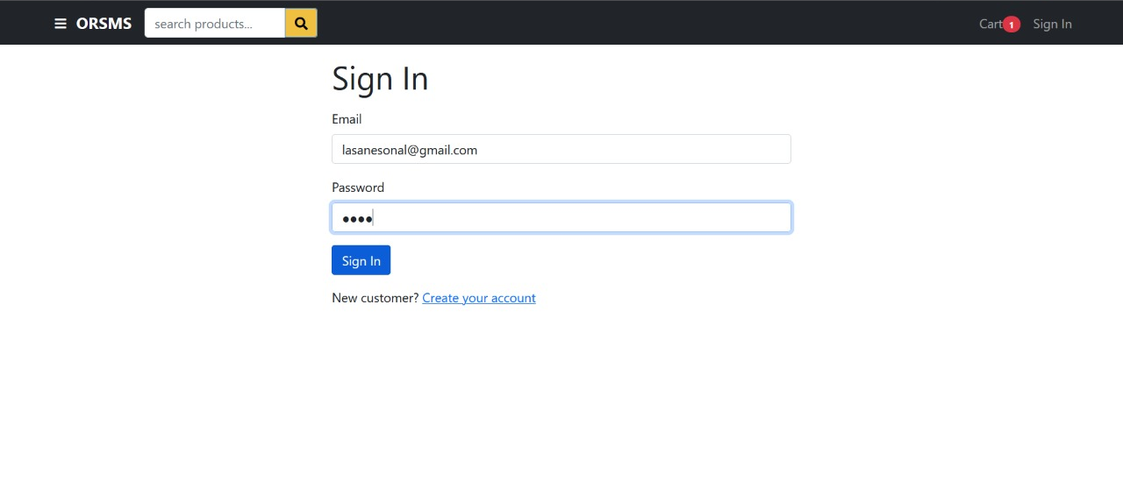
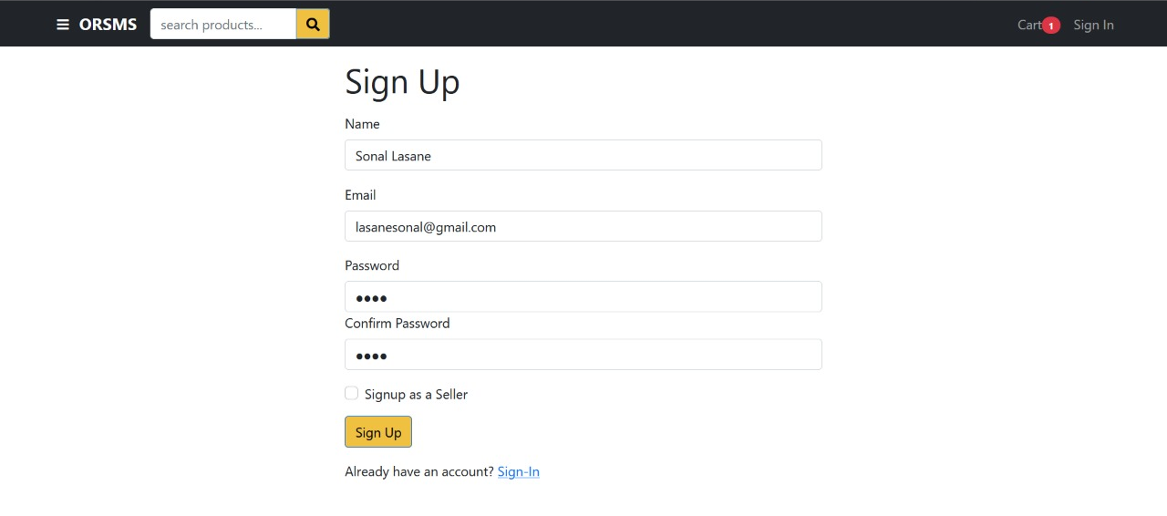
User interfaces
Home Page
Sign In Page
Sign Up Page

Slide 11
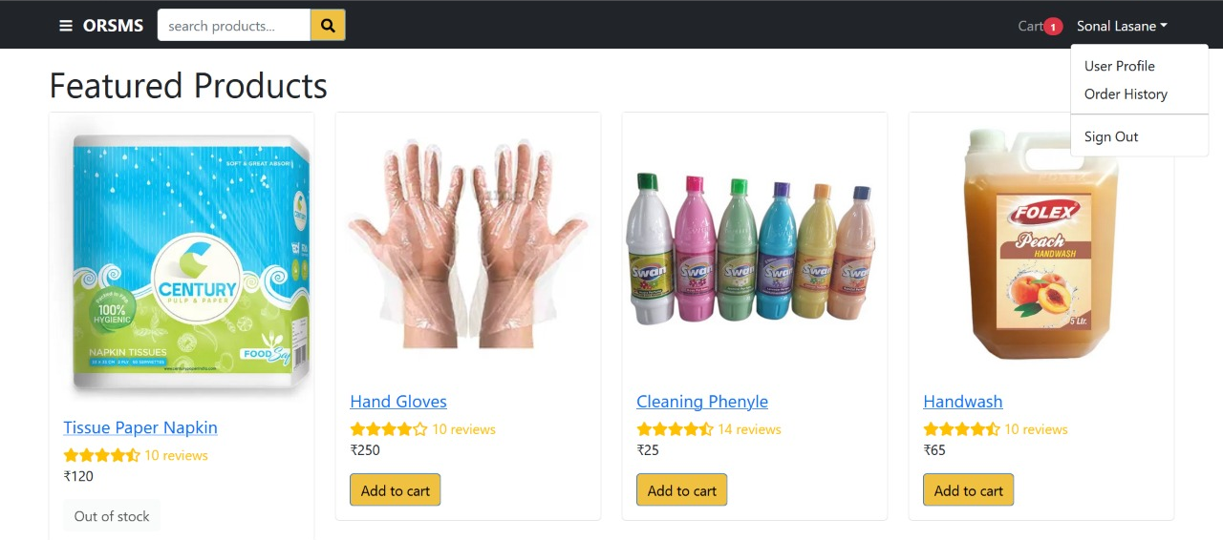


User interfaces
Customer Login
Seller Login
Admin Login

Slide 12
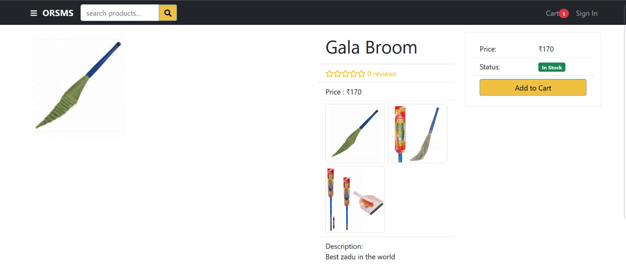
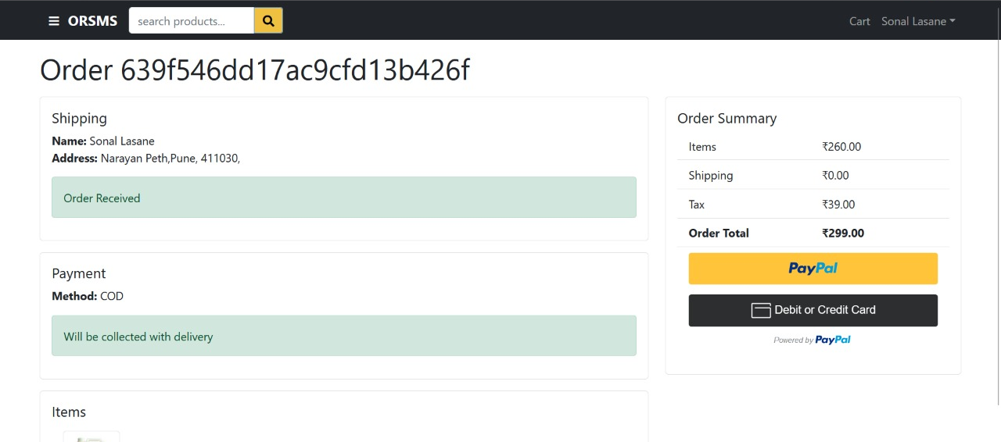
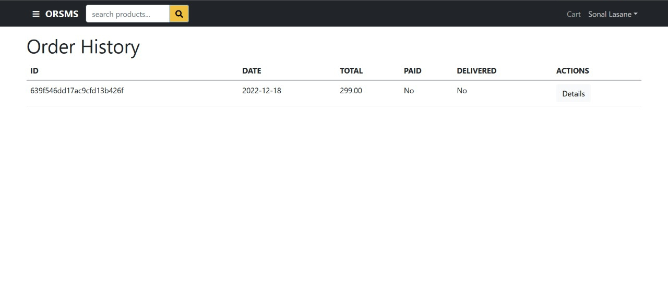
User interfaces
Product Details
Order Confirmation
Order History

Slide 13
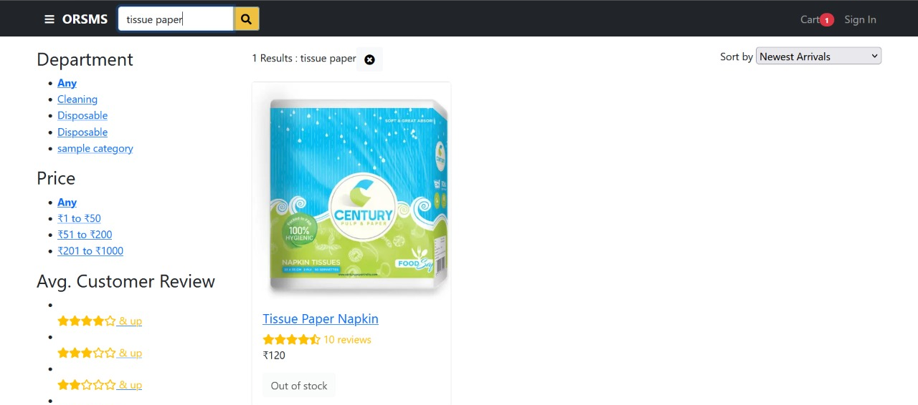
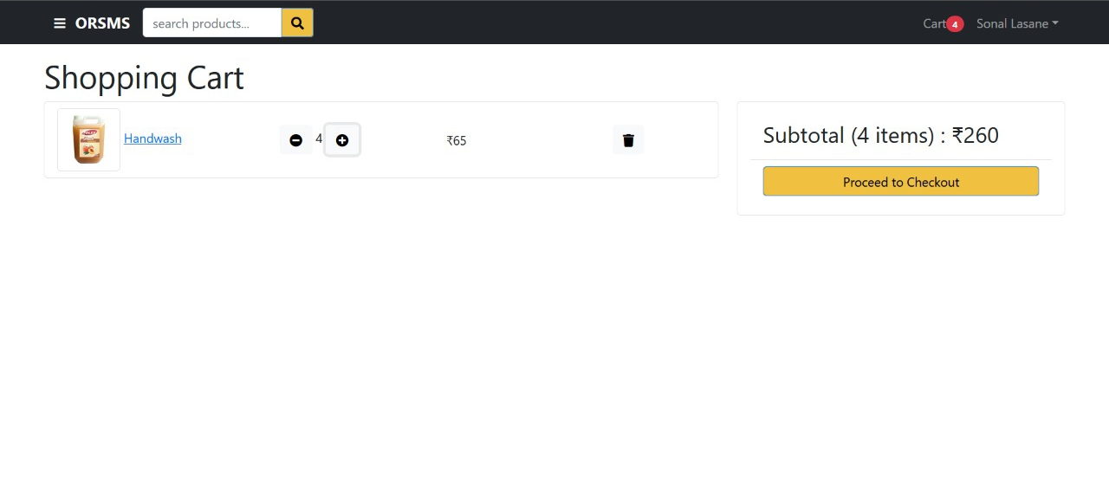
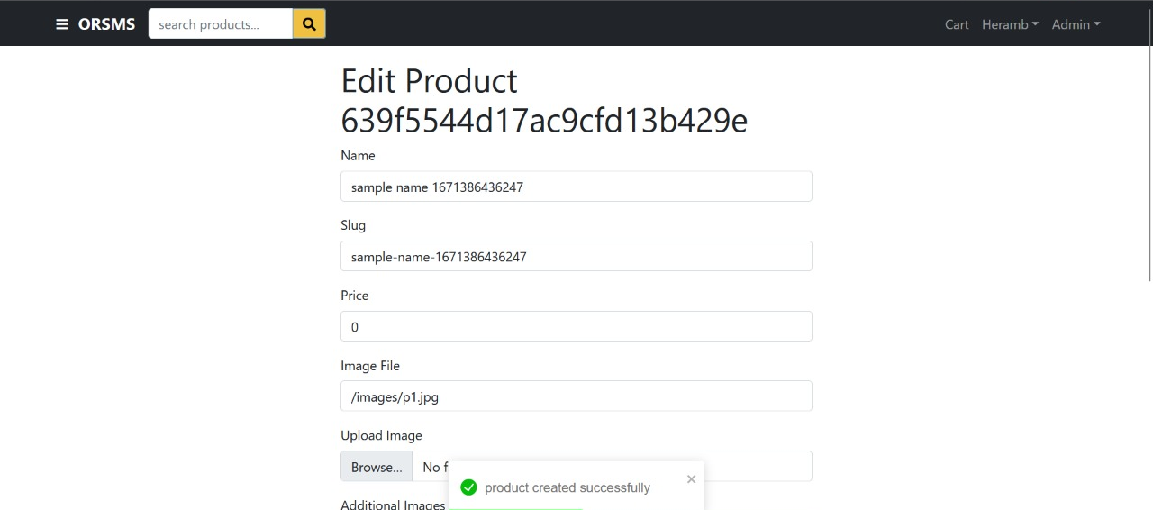
User interfaces
Dynamic Cart
Crate Product
Search/Filter Products

Slide 14
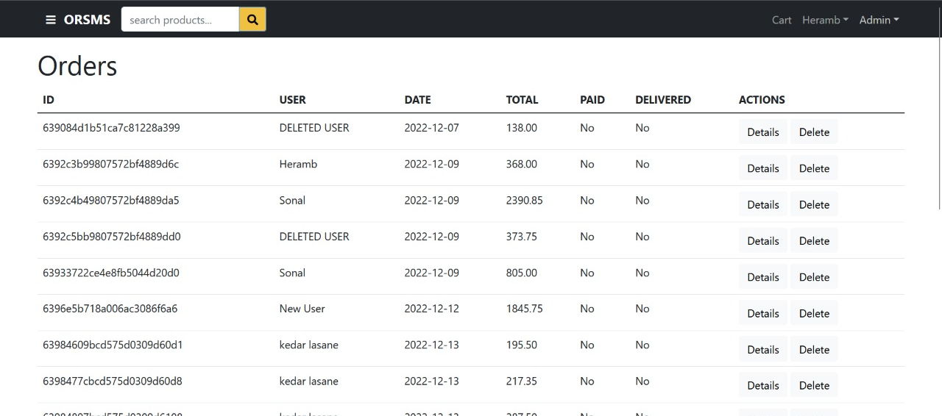
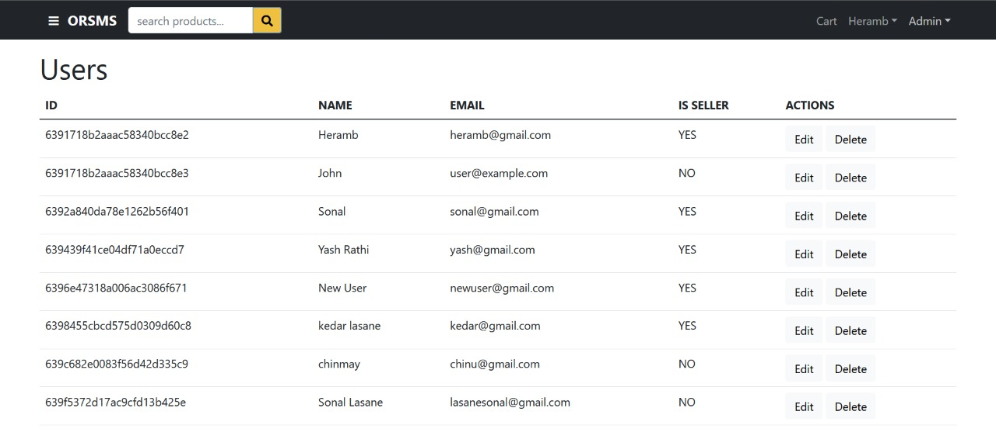
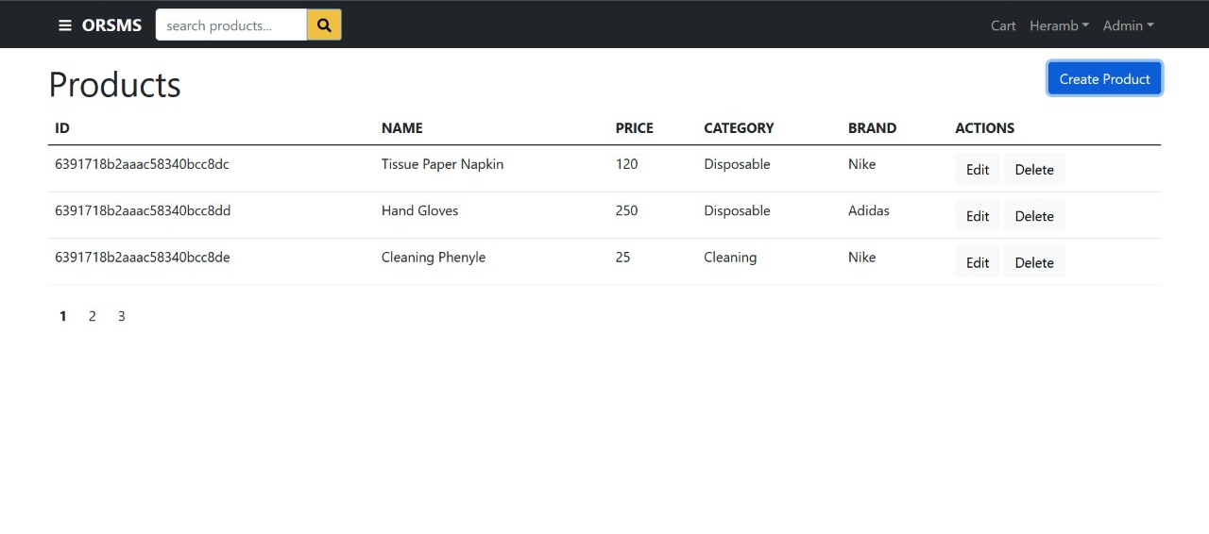
User interfaces
Order List on Admin Login
Users’ List on Admin Login
Products’ List on Admin Login

Slide 15
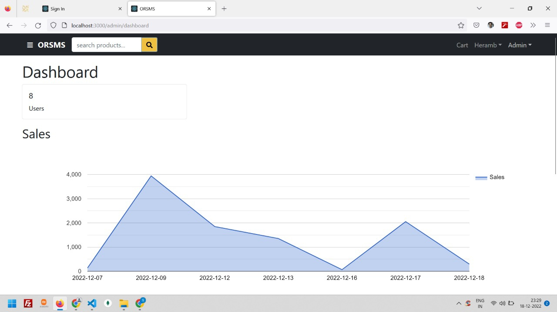
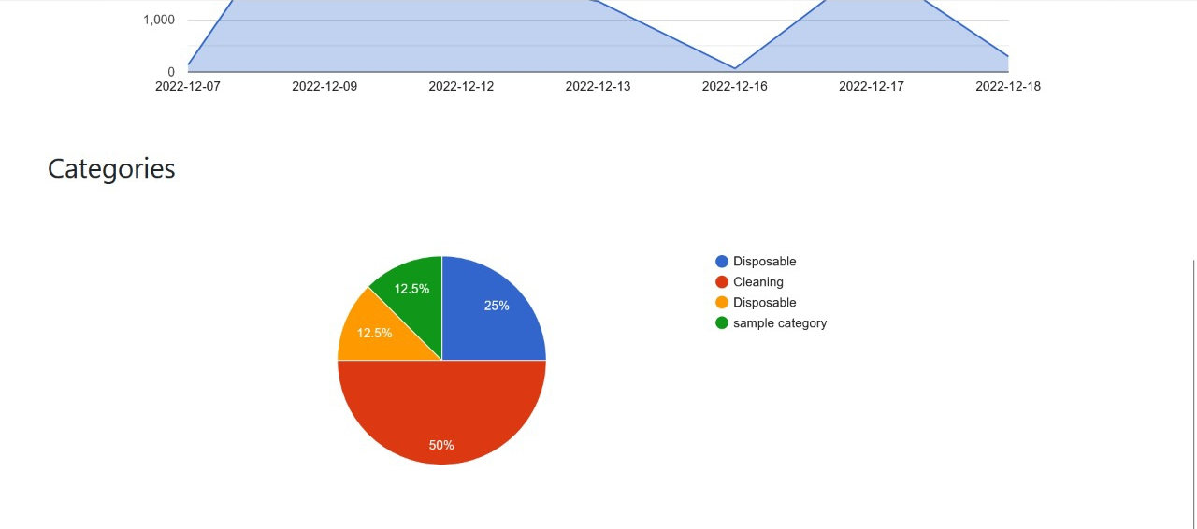
DASHBOARD interfaces
Admin Dashboard 2
Admin Dashboard 1

Slide 16
LIMITATIONS
The size of the database increases day-by-day, increasing the load on the database backup and data maintenance activity.
Training for simple computer operations is necessary for the users working on the system.
Cyber-crimes are increasing day by day, so advanced data security is needed to implement.
It is concluded that there would be a need of an independent platform where the orders in specific area (based on pin-code) are listed. These orders can be allocated to respective delivery persons in the same area.
Huge shipping cost expenditure to deliver those products to their end users.

Slide 17
Future enhancements
This System being web-based and an undertaking of the Cyber Security Division, needs to be thoroughly tested to find out any security gaps.
Multiple payment options including Unified Payments’ Interface (UPI), Net Banking, etc. can be provided in more efficient and secure way.
An order can be tracked more efficiently and real-time using an independent platform that handles order delivery for this platform.

Slide 18
Conclusion
ORSMS is designed for better experience & to avail an ‘Ease of Doing Business’ to user. No need to download it manually though anonymous websites. This platform can be feasible for any person who does job or business full day. This platform is also useful for MSMEs, startups, etc.
Security is maintained as the complete regional control of the system is maintained so that no malware can affect any one of the users’ Mobile or Computers. This platform will help publisher to avoid misuse of their products and data corruption.
Also this platform will produce many job opportunities, as it will need huge manpower for delivering & tracking products, business and commerce-related operations, etc.

Slide 19
BIBLIOGRAPHY
Software Engineering
HTML & Web Designing
Fundamentals of web development by RANDY CONNOLLY AND RICARDO HOAR
https://www.w3schools.com
https://developer.mozilla.org
https://github.com

Slide 20
THANK YOU…

